Slide 1
R PACKAGE WRITING
Operationalizing your algorithms

Slide 2

what is a package
The fundamental unit of shareable code in R
A collection of functions that is available to the user once the package is installed on the user's device.
Will often include function help files, vignettes, sample data, and more.
A convenient way to organize and automate commands that you use frequently.
packager

Slide 3
why we use packages
Organizing your commonly used code
Standardized conventions lead to standardized tools
Saves time
Sharing code (inside or outside your org)
packager

Slide 4

prerequisites

Slide 5
packages required
Regardless of your operating system, you will need to install some packages to begin your package-writing career:
# make sure that you have the necessary package-writing packages installed
install.packages(c("devtools", "roxygen2", "testthat","knitr"))

Slide 6
proper environment
If you’re using Windows, you will need to install Rtools
After installation, you will need to verify that your system can find Rtools. If your system is set up correctly, the has_devel() function should return TRUE
# make sure that your system knows where to find everything you'll need
devtools::find_rtools()
# make sure that your set up is ready to construct R packages
devtools::has_devel()

Slide 7

Creating the framework
Every R package has the same basic shell

Slide 8
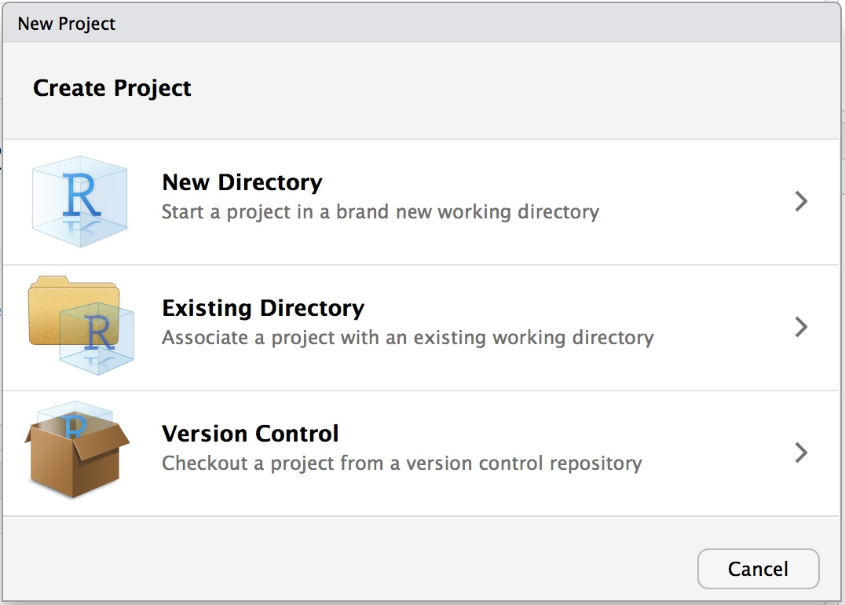
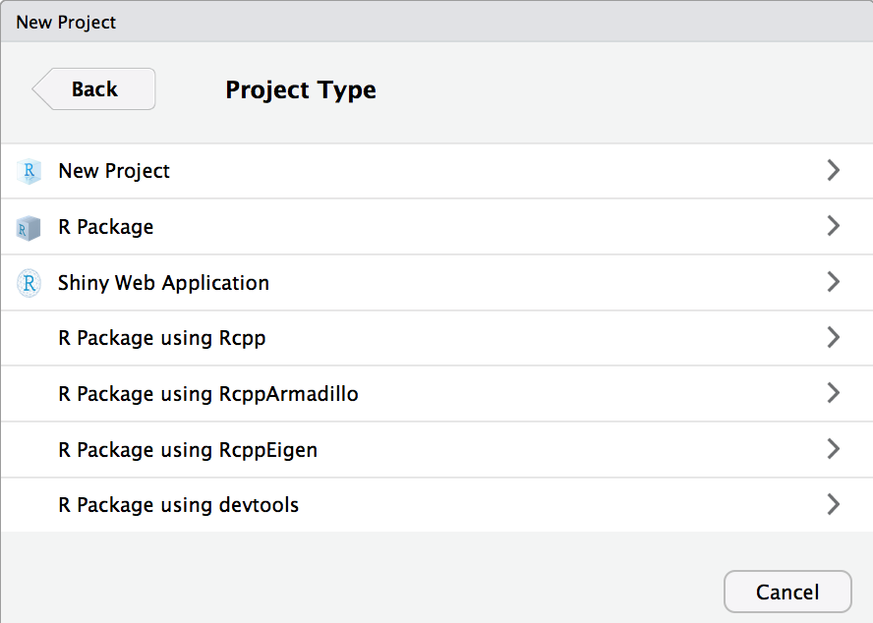
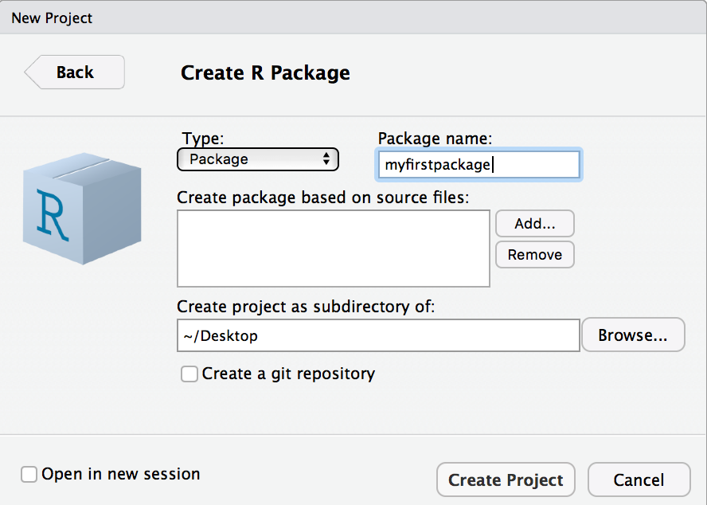
Setting up an r package Project
File >> New Project
Alternatively: devtools::create("path/to/myPackage")
utils::package.skeleton("myPackage")
Rcpp::rcpp.package.skeleton("myPackage")

Slide 9
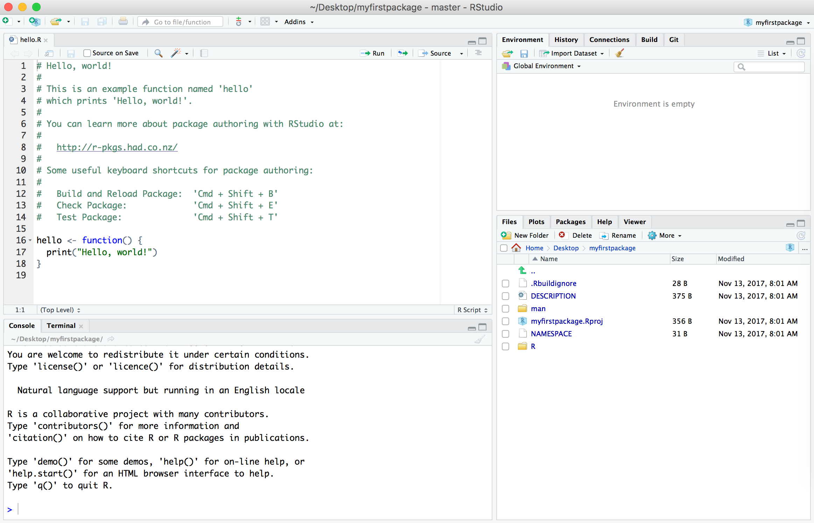
main package components
Every R package has three main components:
DESCRIPTION file
NAMESPACE file
An R/ directory containing R code/functions

Slide 10
Other package components
man/ directory of documentation files for exported functions (becomes the help/ directory after compilation)
src/ directory of compiled code (C++ / C / FORTRAN) (becomes the libs/ directory after compilation)
data/ directory of exported datasets (as .Rdata files)
examples/ directory stand-alone examples
vignettes/ directory of long-form documentation files or research papers
tests/ directory of function tests
inst/ directory of content not contained elsewhere (everything moves up one-level after compilation)

Slide 11

DESCRIPTION & NAMESPACE
Creating your package metadata

Slide 12
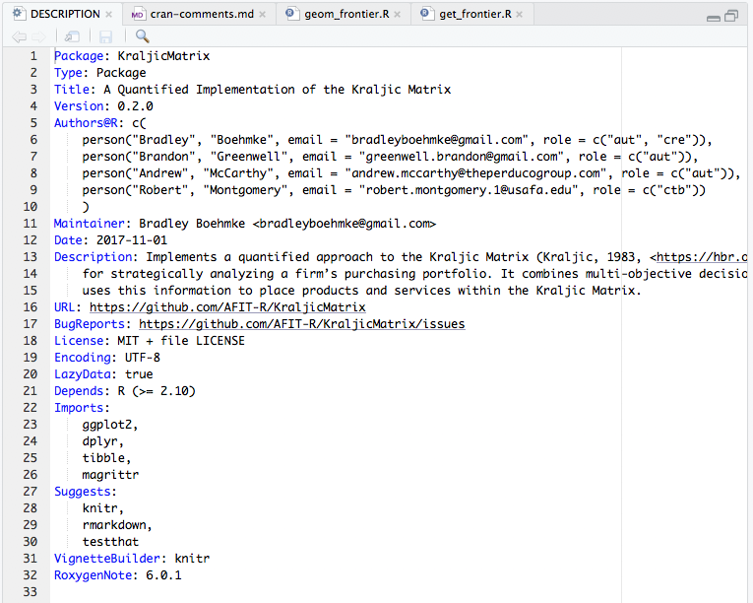
Description File
Must be at the top of the package directory
Contains package metadata: title, description, authors, current version number, etc.
Imports: packages containing functions used by your package. These will be automatically installed when your package is installed
Suggests: packages that will make your set of functions more useful and effective, but aren't necessary
Depends: packages that provide a core capability to your package (these should be kept to a minimum)

Slide 13
WHAT'S IN A NAME(SPACE)?
The NAMESPACE file provides a 'space' for 'names'.
Provides a context for looking up the value of an object associated with a name
Make your packages self-contained via imports and exports
imports: define how functions in your package finds functions in another
exports: specify which functions in your package are available outside of your package to help avoid conflicts
We won't edit the NAMESPACE file directly – the roxygen2 package will allow us to keep everything contained with the function in the .R file

Slide 14
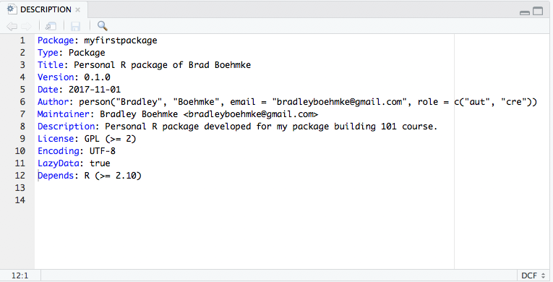
Your turn!
Update and save your DESCRIPTION file to look something like the following:

Slide 15
Packaging Functions
The R/ directory contains the capabilities of your package

Slide 16
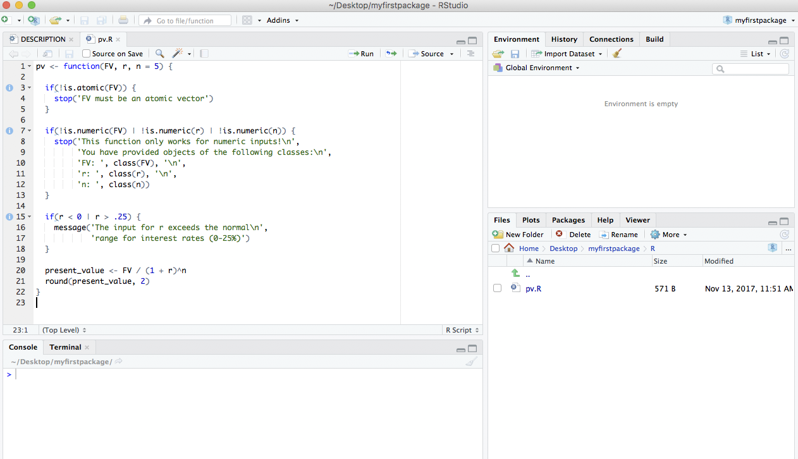
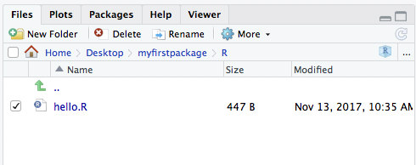
Writing user defined Functions
To have a working R Package you need a set of functions (or data)
We'll create two example functions pv and rescale as examples
Delete the hello.R file in the R directory & the hello.Rd file in the man directory
Create two new .R script files, named pv.R and rescale.R in the R/ directory

Slide 17
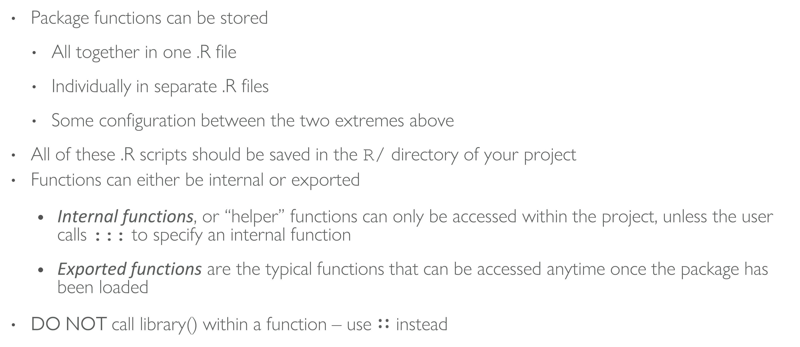
some things to remember
Package functions can be stored
All together in one .R file
Individually in separate .R files
Some configuration between the two extremes above
All of these .R scripts should be saved in the R/ directory of your project
Functions can either be internal or exported
Internal functions, or “helper” functions can only be accessed within the project, unless the user calls ::: to specify an internal function
Exported functions are the typical functions that can be accessed anytime once the package has been loaded
DO NOT call library() within a function – use $∷$ instead

Slide 18

function Fundamentals

Slide 19
when to write functions
df <- data.frame(
a = rnorm(10),
b = rnorm(10),
c = rnorm(10),
d = rnorm(10)
)
df$a <- (df$a - min(df$a, na.rm = TRUE)) /
(max(df$a, na.rm = TRUE) - min(df$a, na.rm = TRUE))
df$b <- (df$b - min(df$b, na.rm = TRUE)) /
(max(df$a, na.rm = TRUE) - min(df$b, na.rm = TRUE))
df$c <- (df$c - min(df$c, na.rm = TRUE)) /
(max(df$c, na.rm = TRUE) - min(df$c, na.rm = TRUE))
df$d <- (df$d - min(df$d, na.rm = TRUE)) /
(max(df$d, na.rm = TRUE) - min(df$d, na.rm = TRUE))
You should consider writing a function whenever you’ve copied and pasted a block of code more than twice.
Can you spot the error?

Slide 20
when to write functions
df <- data.frame(
a = rnorm(10),
b = rnorm(10),
c = rnorm(10),
d = rnorm(10)
)
df$a <- (df$a - min(df$a, na.rm = TRUE)) /
(max(df$a, na.rm = TRUE) - min(df$a, na.rm = TRUE))
df$b <- (df$b - min(df$b, na.rm = TRUE)) /
(max(df$a, na.rm = TRUE) - min(df$b, na.rm = TRUE))
df$c <- (df$c - min(df$c, na.rm = TRUE)) /
(max(df$c, na.rm = TRUE) - min(df$c, na.rm = TRUE))
df$d <- (df$d - min(df$d, na.rm = TRUE)) /
(max(df$d, na.rm = TRUE) - min(df$d, na.rm = TRUE))
You should consider writing a function whenever you’ve copied and pasted a block of code more than twice.
Can you spot the error?

Slide 21
function overview
Functions convert input objects into output objects or plots (graphical objects)
Functions can take any non-graphical object as an argument, even other functions
Functions operate on distinct classes of objects (or functions)
Functions can return objects of the same class as the input objects or create a completely new class of object

Slide 22
defining your own function
my_fun <- function(arg1, arg2) {
body
}
Functions have 3 parts:
formals (aka arguments)
body (code inside the function)
environment

Slide 23
defining your own function
pv <- function(FV, r, n) {
present_value <- FV / (1 + r)^n
round(present_value, 2)
}
Functions have 3 parts:
formals (aka arguments)
body (code inside the function)
environment

Slide 24
anatomy of a function
pv <- function(FV, r, n) {
present_value <- FV / (1 + r)^n
round(present_value, 2)
}
formals(pv)
$FV
$r
$n
body(pv)
{
present_value <- FV/(1 + r)^n
round(present_value, 2)
}
environment(pv)
<environment: R_GlobalEnv>
Functions have 3 parts:
formals (aka arguments)
body (code inside the function)
environment

Slide 25
function output
pv <- function(FV, r, n) {
present_value <- FV / (1 + r)^n
round(present_value, 2)
}
pv(FV = 1000, r = .08, n = 5)
[1] 680.58
pv2 <- function(FV, r, n) {
present_value <- FV / (1 + r)^n
return(present_value)
round(present_value, 2)
}
pv2(1000, .08, 5)
[1] 680.5832
What gets returned from a function is either:
The last expression evaluated
return(value), which forces the function to stop execution and return value

Slide 26
function output
pv <- function(FV, r, n) {
present_value <- FV / (1 + r)^n
round(present_value, 2)
}
pv(FV = 1000, r = .08, n = 5)
[1] 680.58
pv2 <- function(FV, r, n) {
present_value <- FV / (1 + r)^n
return(present_value)
round(present_value, 2)
}
pv2(1000, .08, 5)
[1] 680.5832
What gets returned from a function is either:
The last expression evaluated
return(value), which forces the function to stop execution and return value
Note the differences in how we call these functions. Why do both cases work?

Slide 27
Your turn!
Define a function titled ratio that takes arguments x, y, and digits and returns the value of their ratio, x / y, rounded to a specified number of digits.
Call ratio() with arguments 3, 7, and 4

Slide 28
solution
ratio <- function(x, y, digits) {
round(x / y, digits = digits)
}
ratio(3, 7, 4)
[1] 0.4286

Slide 29
lexical scoping rules
R uses lexical scoping rules to define how functions and objects interact
The code to the right creates two functions called foo( ) and bar()
Observing this code, what value will result if bar(2) is called?
a <- 1
b <- 2
foo <- function(x) {
a * x + b
}
bar <- function(x){
a <- 2
b <- 1
foo(x)
}

Slide 30

handling arguments

Slide 31
Calling arguments in different ways
pv(FV = 1000, r = .08, n = 5)
[1] 680.58
pv(1000, .08, 5)
[1] 680.58
pv(r = .08, FV = 1000, n = 5)
[1] 680.58
pv(.08, 1000, 5)
[1] 0
pv(1000, .08)
Error in pv(1000, 0.08) : argument "n" is missing, with no default
Using argument names
positional matching
must use names if you change order otherwise…
error or incorrect computation will occur
missing arguments results in error

Slide 32
setting default arguments
pv <- function(FV, r, n = 5) {
present_value <- FV / (1 + r)^n
round(present_value, 2)
}
pv(1000, .08)
[1] 680.58
PV(1000, .08, n = 3)
[1] 793.83
We can set default argument values
now if we do not call the argument the default is used
and we can change the default simply by specifying an n value

Slide 33
ordering arguments
Ordering arguments in your functions is important:
positional matching
pipe (%>%) operator
my_fun <- function(data, arg2, arg3 = 5) {
body
}
General rules:
Data argument first
First couple arguments require specifying
Later arguments have defaults

Slide 34
Your turn!
Earlier in these slides you saw the following code duplicated:
(df$a - min(df$a, na.rm = TRUE)) /
(max(df$a, na.rm = TRUE) - min(df$a, na.rm = TRUE))
Can you write a function called rescale that takes argument x and executes this code?
Test your function on the following vector
set.seed(123)
vec1 <- runif(10, min = 5, max = 13)

Slide 35
solution
rescale <- function(x){
rng <- range(x, na.rm = TRUE)
(x - rng[1]) / (rng[2] - rng[1])
}
set.seed(123)
vec1 <- runif(10, min = 5, max = 13)
rescale(vec1)
[1] 0.2704415 0.8299695 0.4060968 0.9358038 1.0000000 0.0000000 0.5392146
[8] 0.9463095 0.5652837 0.4593287

Slide 36
Your turn!
Now add an argument to rescale that allows you to round the output to a specified decimal. Set the default to 2.

Slide 37
solution
rescale <- function(x, digits = 2){
rng <- range(x, na.rm = TRUE)
scaled <- (x - rng[1]) / (rng[2] - rng[1])
round(scaled, digits = digits)
}
set.seed(123)
vec1 <- runif(10, min = 5, max = 13)
rescale(vec1)
[1] 0.27 0.83 0.41 0.94 1.00 0.00 0.54 0.95 0.57 0.46
rescale(vec1, 3)
[1] 0.270 0.830 0.406 0.936 1.000 0.000 0.539 0.946 0.565 0.459

Slide 38
Your turn!
Now let’s move the na.rm = TRUE argument into the function's formals so that the user can specify whether or not they want to remove NAs. Set the default to TRUE.

Slide 39
solution
Showing how many missing values were removed
rescale <- function(x, digits = 2, na.rm = TRUE){
if(isTRUE(na.rm)) x <- na.omit(x)
rng <- range(x)
scaled <- (x - rng[1]) / (rng[2] - rng[1])
round(scaled, digits = digits)
}
vec1 <- c(NA, vec1)
rescale(vec1)
[1] 0.27 0.83 0.41 0.94 1.00 0.00 0.54 0.95 0.57 0.46
attr(,"na.action")
[1] 1
attr(,"class")
[1] "omit"

Slide 40
solution
Hiding how many missing values were removed
rescale <- function(x, digits = 2, na.rm = TRUE){
if(isTRUE(na.rm)) x <- x[!is.na(x)]
rng <- range(x)
scaled <- (x - rng[1]) / (rng[2] - rng[1])
round(scaled, digits = digits)
}
rescale(vec1)
[1] 0.27 0.83 0.41 0.94 1.00 0.00 0.54 0.95 0.57 0.46

Slide 41
Your turn!
Now try to apply the rescale function across each variable in the mtcars data set.
Hint: try using one of the apply or map functions.

Slide 42
solution
You can now apply this function over a data frame, list, matrix with the map function
library(purrr)
mtcars %>%
map_df(rescale)
# A tibble: 32 × 11
mpg cyl disp hp drat wt qsec vs am gear carb
<dbl> <dbl> <dbl> <dbl> <dbl> <dbl> <dbl> <dbl> <dbl> <dbl> <dbl>
1 0.45 0.5 0.22 0.20 0.53 0.28 0.23 0 1 0.5 0.43
2 0.45 0.5 0.22 0.20 0.53 0.35 0.30 0 1 0.5 0.43
3 0.53 0.0 0.09 0.14 0.50 0.21 0.49 1 1 0.5 0.00
4 0.47 0.5 0.47 0.20 0.15 0.44 0.59 1 0 0.0 0.00
5 0.35 1.0 0.72 0.43 0.18 0.49 0.30 0 0 0.0 0.14
6 0.33 0.5 0.38 0.19 0.00 0.50 0.68 1 0 0.0 0.00
7 0.17 1.0 0.72 0.68 0.21 0.53 0.16 0 0 0.0 0.43
8 0.60 0.0 0.19 0.04 0.43 0.43 0.65 1 0 0.5 0.14
9 0.53 0.0 0.17 0.15 0.53 0.42 1.00 1 0 0.5 0.14
10 0.37 0.5 0.24 0.25 0.53 0.49 0.45 1 0 0.5 0.43
# ... with 22 more rows

Slide 43

invalid parameters

Slide 44
invalid parameters
For functions that will be re-used, and especially for those used by someone other than the creator, it is good to check the validity of the arguments.
my_fun <- function(data, arg2, arg3 = 5) {
if(condition) {
message or warning
}
body
}
Common issues:
Making sure data is in the right structure (i.e. df, list, vector)
Are the argument inputs the right class (i.e. numeric, character)
Are the argument inputs within the proper boundary limits

Slide 45
invalid parameters
Our pv function works on a vector of future values, not data frames, lists, or matrices. Let’s add a warning in case a user tries to feed it a non-atomic vector.

Slide 46
invalid parameters
Our pv function works on a vector of future values, not data frames, lists, or matrices. Let’s add a warning in case a user tries to feed it a non-atomic vector.
pv <- function(FV, r, n = 5) {
if(!is.atomic(FV) {
stop('FV must be an atomic vector')
}
present_value <- FV / (1 + r)^n
round(present_value, 2)
}
Check if class of FV is something other than a vector (be careful with is.vector - use is.atomic instead)
If so, stop, return an error, and the specified message

Slide 47
invalid parameters
Our pv function works on a vector of future values, not data frames, lists, or matrices. Let’s add a warning in case a user tries to feed it a non-vector.
fv_l <- list(fv1 = 800,
fv2 = 900,
fv3 = 1100)
pv(fv_l, 0.08)
Error in pv(fv_l, 0.08) : FV must be an atomic vector
Now when we execute pv on a non-atomic vector we get an error output

Slide 48
invalid parameters
Now let’s add tests for the type of class input.
pv <- function(FV, r, n = 5) {
if(!is.atomic(FV)) {
stop('FV must be an atomic vector')
}
if(!is.numeric(FV) | !is.numeric(r) | !is.numeric(n)){
stop('This function only works for numeric inputs!\n',
'You have provided objects of the following classes:\n',
'FV: ', class(FV), '\n',
'r: ', class(r), '\n',
'n: ', class(n))
}
present_value <- FV / (1 + r)^n
round(present_value, 2)
}
Now we test for
data type
argument class
and both of these will provide warnings if violated

Slide 49
invalid parameters
Now let’s add tests for the type of class input.
pv(FV = "1000", .08, n = 5)
Error in pv(FV = "1000", 0.08, n = 5) :
This function only works for numeric inputs!
You have provided objects of the following classes:
FV: character
r: numeric
n: numeric
Now we test for
data type
argument class
and both of these will provide warnings if violated

Slide 50
invalid parameters
What else can you think of?

Slide 51
invalid parameters
What else can you think of? What about abnormal interest rate ranges?
pv <- function(FV, r, n = 5) {
if(!is.atomic(FV)) {
stop('FV must be an atomic vector')
}
if(!is.numeric(FV) | !is.numeric(r) | !is.numeric(n)){
stop('This function only works for numeric inputs!\n',
'You have provided objects of the following classes:\n',
'FV: ', class(FV), '\n',
'r: ', class(r), '\n',
'n: ', class(n))
}
if(r < 0 | r > .25) {
message('The input for r exceeds the normal\n',
'range for interest rates (0-25%)')
}
present_value <- FV / (1 + r)^n
round(present_value, 2)
}
If we add a message() this allows us to:
notify the user of something
while still executing the code

Slide 52
invalid parameters
What else can you think of? What about abnormal interest rate ranges?
pv(FV = 1000, r = .28, n = 5)
The input for r exceeds the normal
range for interest rates (0-25%)
[1] 1292.36
If we add a message() this allows us to:
notify the user of something
while still executing the code

Slide 53
Your turn!
Go back to the rescale function and add conditional statements to check and provide appropriate errors or messages to ensure that:
x is a numeric vector
digits is a numeric vector of one element
na.rm is a single logical input

Slide 54
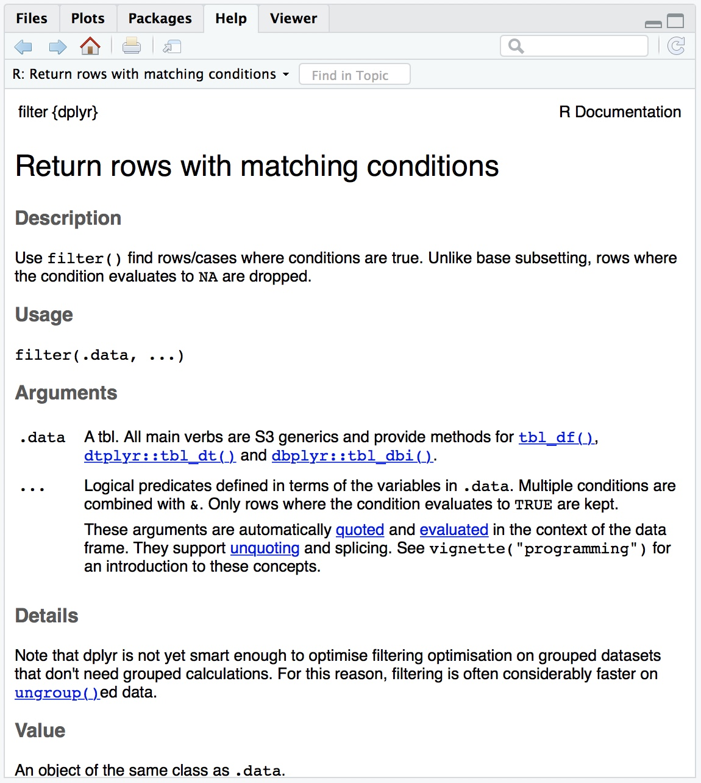
documenting functions
All functions in R come with help menus so that other users (or even yourself in the future) can figure out how to use various functions
We will be using the roxygen2 package to add documentation files
Documentation files are saved as .Rd files in the /man folder of your project
?dplyr::filter

Slide 55
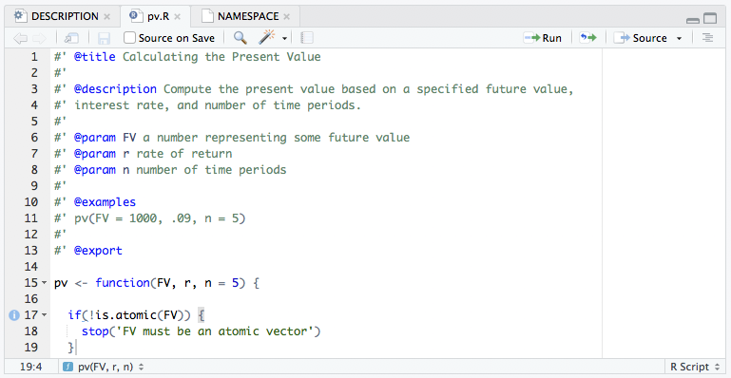
CONSTRUCTING HELP FILES
Directly above the function in the .R file, add various categories with a leading #’
You should always include @title, @description, @param, @examples, and @export
Once you have incorporated these comments, type devtools::document() in your console.
This creates:
.Rd file in man directory
Adds pv function to package NAMESPACE

Slide 56
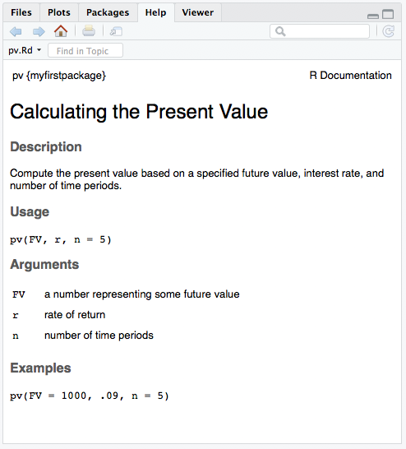
test drive your function
Once you’ve created your function and added it to the NAMESPACE you can:
# Load your development package functions
devtools::load_all()
# Look at help file documentation
?pv
# Test your function out
pv(FV = 1000, .09, n = 5)
[1] 649.93
# Test that your current package meets CRAN
# requirements
devtools::check()

Slide 57
common workflow
# Document your package functions
devtools::document()
# Load your package functions
devtools::load_all()
# Evaluate your package against requirements
devtools::check()
Shortcuts:
Ctrl/Cmd + Shift + D
Ctrl/Cmd + Shift + L
Ctrl/Cmd + Shift + E
Rinse and repeat

Slide 58
some things to remember
All functions can be written in a single .R script, each function can be in a different script, or some other configuration in between these two extremes
All of these .R scripts should be saved in the /R folder of your project
Functions can either be internal or exported
Internal functions, or “helper” functions can only be accessed within the project, unless the user calls ::: to specify an internal function
Exported functions are the typical functions that can be accessed anytime once the package has been loaded
DO NOT call libraries within functions using library()

Slide 59
Your turn!
Add the rescale function to your package:
Create new .R script
Add rescale function
Add roxygen comments to document help file
Run devtools::document() to add to NAMESPACE
Load function with devtools::load_all() (check our help file, test function)
Run devtools::check()

Slide 60
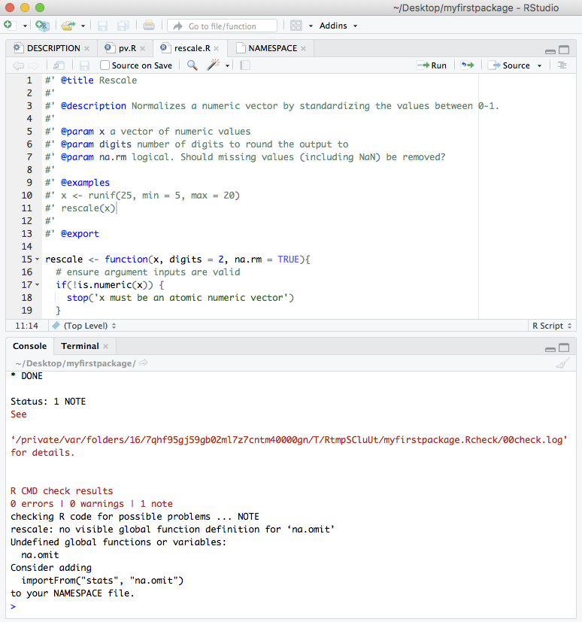
A function with dependencies
2 approaches
Add stats package to dependencies with devtools::use_package(“stats”). Then refer to function explicitly (stats::na.omit)
Add stats::na.omit to NAMESPACE with @importFrom stats na.omit
Add this dependency, rerun devtools::document() and devtools::check() and you should be clear!

Slide 61

Adding example data

Slide 62
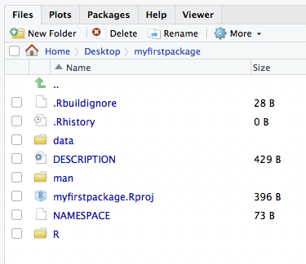
Setting up the data
# 1. Import the data you want to use
psc <- readr::read_csv("path/to/pkg_data.csv")
# 2. Add the data object to your package
devtools::use_data(psc)

Slide 63
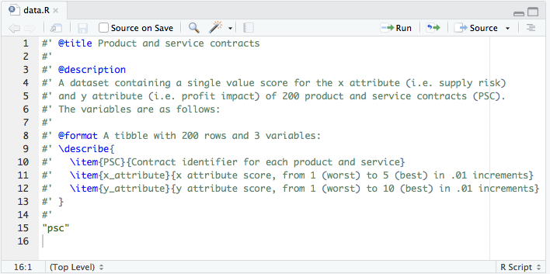
Setting up the data
# 1. Import the data you want to use
psc <- readr::read_csv("path/to/pkg_data.csv")
# 2. Add the data object to your package
devtools::use_data(psc)
# 3. Document data using roxygen comments then run
devtools::document()
devtools::load_all()
?psc
psc
devtools::check()

Slide 64

Integrated testing
Know when your code breaks!

Slide 65
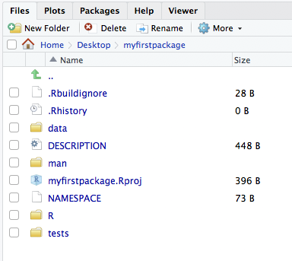
Description File
Automated testing reduces the time to find and fix bugs
Formalizes testing to ensure consistency
To get started, run devtools::use_testthat()

Slide 66
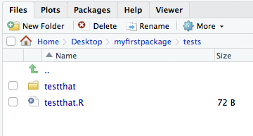
Description File
Automated testing reduces the time to find and fix bugs
Formalizes testing to ensure consistency
To get started, run devtools::use_testthat()
Inside the tests directory, there are two things:
testthat.R file that runs tests (don’t touch!)
testthat folder where you save your tests

Slide 67
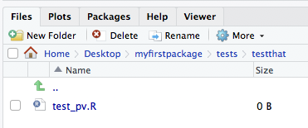
creating a test
Create a new .R script
Title it test_pv (all test files must start with “test” and I typically have one test file per function).
Save it in tests/testthat directory

Slide 68
constructing tests
test_that(“text here to describe test”, {
expect_xxx(function(x), ___)
})

Slide 69
constructing tests
test_that("pv provides proper messages and warnings", {
expect_error(pv(FV = "1000", .09, n = 5))
expect_error(pv(FV = list(1, 2, 3), .09, n = 5))
expect_message(pv(FV = 1000, .36, n = 5))
})
The common types of tests include…
Testing for warnings & messages

Slide 70
constructing tests
test_that("pv provides proper messages and warnings", {
expect_error(pv(FV = "1000", .09, n = 5))
expect_error(pv(FV = list(1, 2, 3), .09, n = 5))
expect_message(pv(FV = 1000, .36, n = 5))
})
test_that("pv has correct dimensions and output type", {
expect_is(pv(FV = 1000, .09, n = 5), "numeric")
expect_true(is.vector(pv(FV = c(1000, 2000), .09, n = 5)))
expect_length(pv(FV = c(1000, 2000), .09, n = 5), 2)
})
The common types of tests include…
Testing for warnings & messages
Testing for correct type of outputs

Slide 71
constructing tests
test_that("pv provides proper messages and warnings", {
expect_error(pv(FV = "1000", .09, n = 5))
expect_error(pv(FV = list(1, 2, 3), .09, n = 5))
expect_message(pv(FV = 1000, .36, n = 5))
})
test_that("pv has correct dimensions and output type", {
expect_is(pv(FV = 1000, .09, n = 5), "numeric")
expect_true(is.vector(pv(FV = c(1000, 2000), .09, n = 5)))
expect_length(pv(FV = c(1000, 2000), .09, n = 5), 2)
})
test_that("pv computes correctly", {
expect_equal(pv(FV = 1000, .09, n = 5), 649.93)
expect_lt(pv(FV = 1000, .09, n = 5), 650)
expect_gt(pv(FV = 1000, .09, n = 5), 649)
expect_equal(pv(FV = c(10, 20), .09, n = 5), c(6.5, 13))
})
The common types of tests include…
Testing for warnings & messages
Testing for correct type of outputs
Testing for correct computation

Slide 72
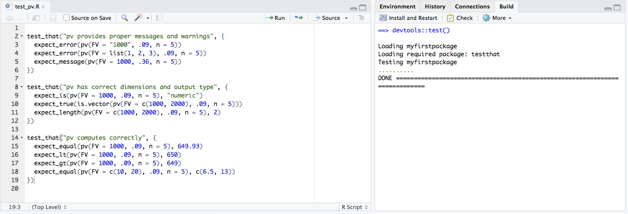
running tests
Once you’ve incorporated your tests, you can run them anytime with devtools::test() (Ctrl/Cmd + Shift + T)
Now, every time you update your functions or make changes to your package you can test quickly and consistently

Slide 73
Your turn!
Integrate testing for our rescale function:
Create test_rescale.R script and save in testthat folder
Create a test to check for:
Creating proper warnings or messages
Check for proper dimensions or output type
Computes correctly
Save and run tests with devtools::test() (Ctrl/Cmd + Shift + T)

Slide 74
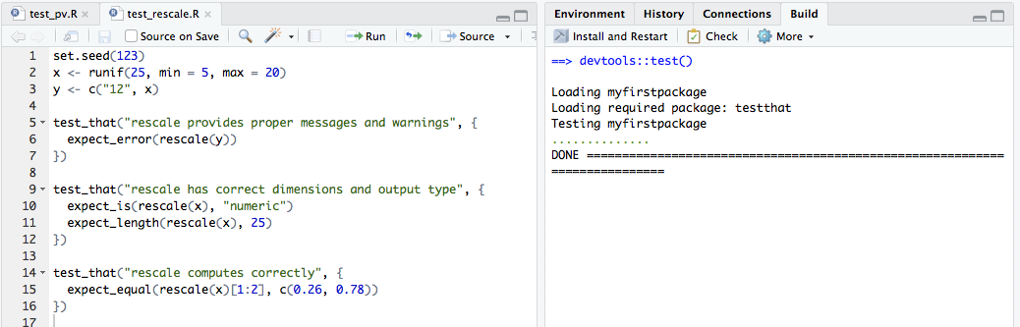
Solution

Slide 75
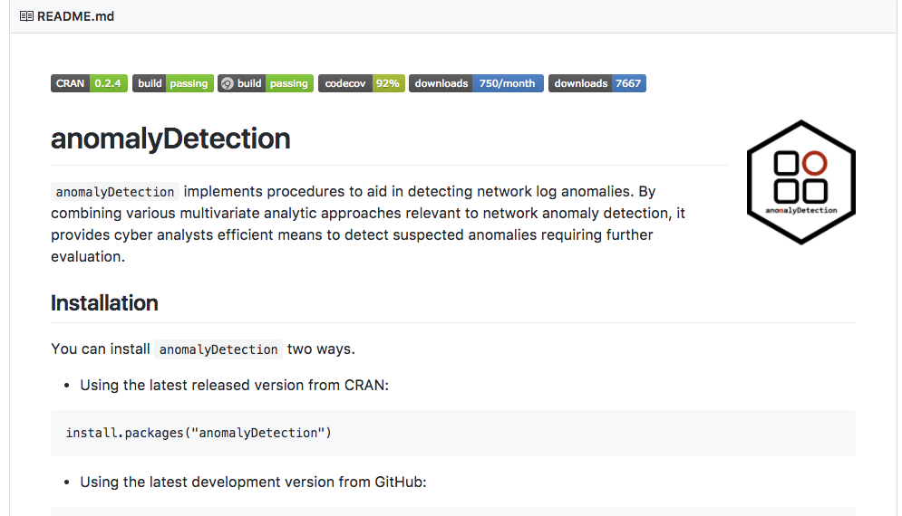
take-away
Once you get the general pattern down, testing is not too complicated
You can create very elaborate tests
You can automate testing online with:
travis.ci
appveyor
codecov

Slide 76
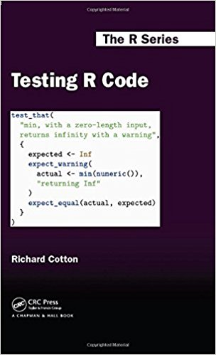
take-away
Once you get the general pattern down, testing is not too complicated
You can create very elaborate tests
You can automate testing online with:
travis.ci
appveyor
codecov
Great book for digging into testing

Slide 77
Vignette
Make it easy to learn about your packages!

Slide 78
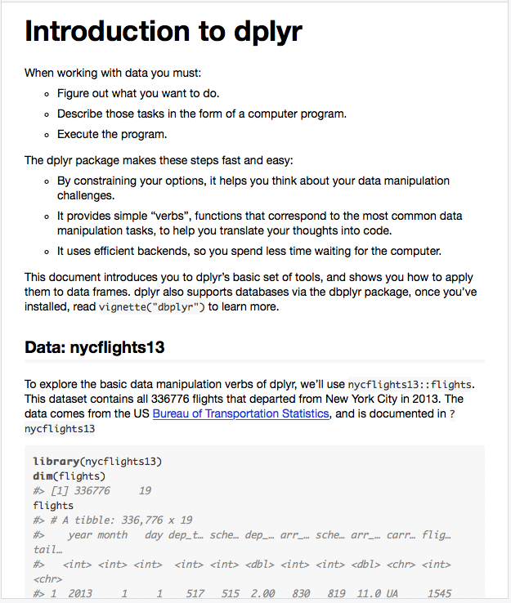
Learning about your package
Most modern packages include a vignette which:
Introduce the purpose for your package
Discuss the functions supplied by your package
Illustrates how someone can use your package
vignette("dplyr")

Slide 79
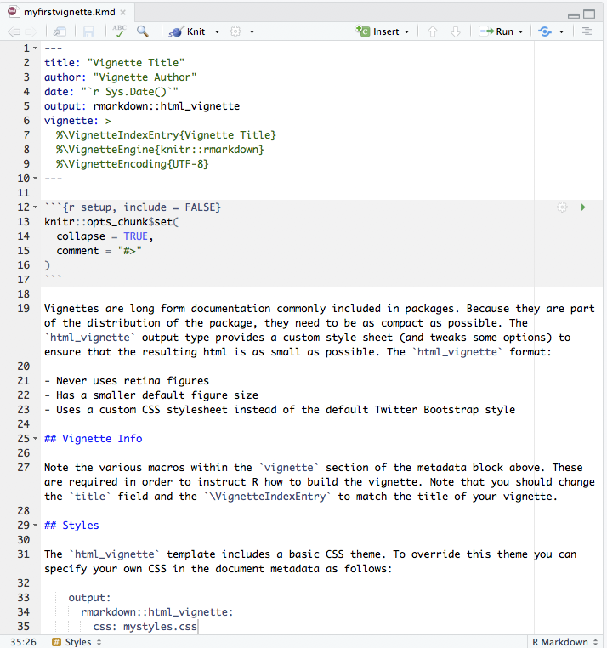
creating a vignette
Initialize a vignette with devtools::use_vignette():
Creates a vignettes/ directory
Adds necessary dependencies to DESCRIPTION file
Creates a draft vignette
devtools::use_vignette("myfirstvignette")

Slide 80
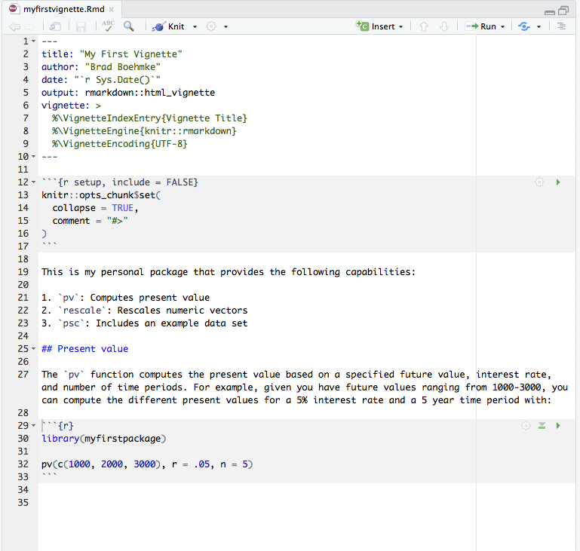
creating a vignette
If you are familiar with R Markdown then vignettes are a piece of cake:
Run devtools::install() in your console to install development version of package on your computer.
Update YAML
Add your own text and headers
Include code chunks (load your package like any other package - library(myfirstpackage))
Anything else you’d want to include to explain this package

Slide 81
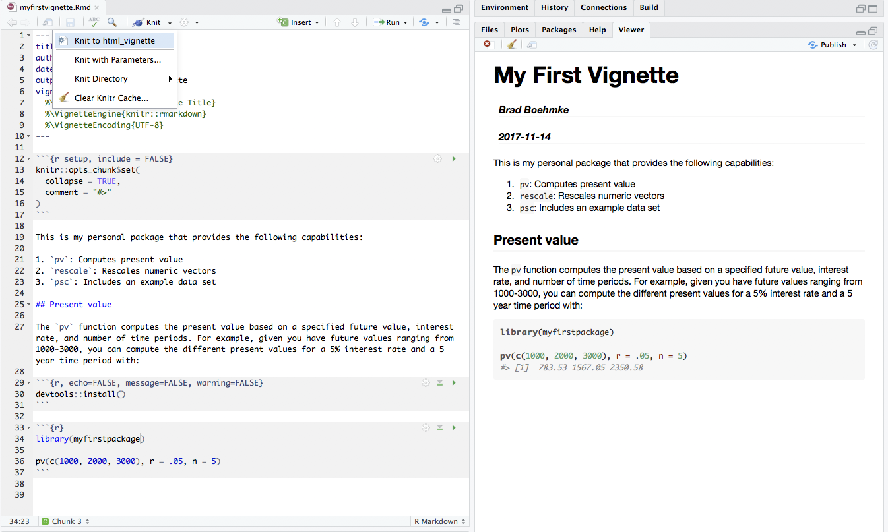
creating a vignette
When you are ready just knit to html_vignette (Ctrl/Cmd + Shift + K)

Slide 82
Your turn!
Take 5 minutes to edit your vignette

Slide 83
Local Deployment
Create a local source package to share

Slide 84
before sharing!
Be sure to run your local tests and checks prior to sharing!
devtools::test()
devtools::check()
Assuming everything checks out fine, let’s proceed with sharing our package

Slide 85
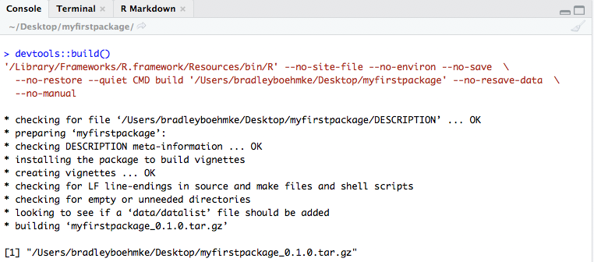
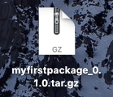
Creating the source file
To share locally, we need to save our packages as a .tar.gz files
devtools::build()
You can now pass along this .tar.gz file

Slide 86
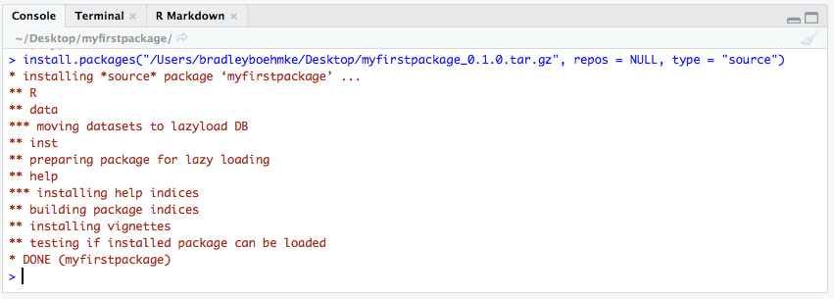
Loading a source file
Load this package with install.packages(“path”, repos = NULL, type = “source”)
# install package from a raw source file
install.packages("/Users/bradleyboehmke/Desktop/myfirstpackage_0.1.0.tar.gz", repos = NULL, type = "source")

Slide 87
Your turn!
Create your source file.
Email to your neighbor.
Load your neighbor’s package.

Slide 88
Public Deployment
Host your package on GitHub or CRAN

Slide 89
Hosting on GitHub
Git & GitHub provide a free version control capability
Allows for easy collaboration and beta development of packages
Allows you to tie into travis.ci, appveyor, codecov and other integrated testing platforms
RStudio allows you to easily integrate GitHub interactions within the IDE

Slide 90
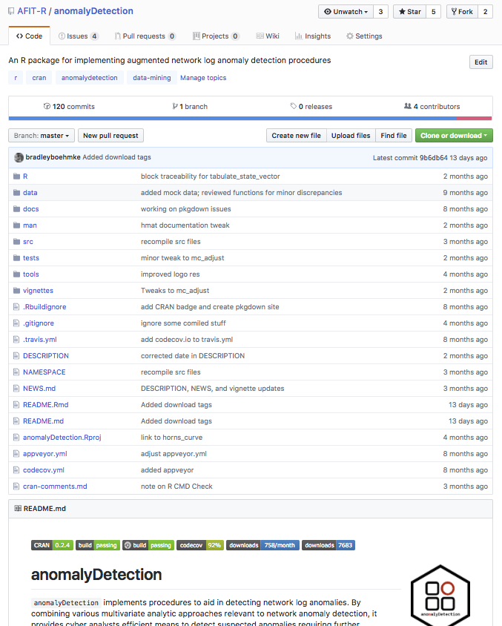
Bugs, suggested improvements, etc.
Collaborators
History
Integrated testing
Package info for public

Slide 91
Hosting on GitHub
To install a package already on GitHub, you must know the Username and Repository that the package resides in
Once you have this information, the install_github command will install the package on your computer.
Because of the size of most vignettes, devtools does not automatically download them from GitHub. If you want to include the vignette, you must add the argument build_vignettes = TRUE
To start posting to GitHub, you will first need to install and set up Git, which is what you'll use to communicate with GitHub. Start by visiting http://git-scm.com/download and installing Git for your system.
# download package from GitHub
devtools::install_github(“Username/Repository”, build_vignettes = TRUE)

Slide 92
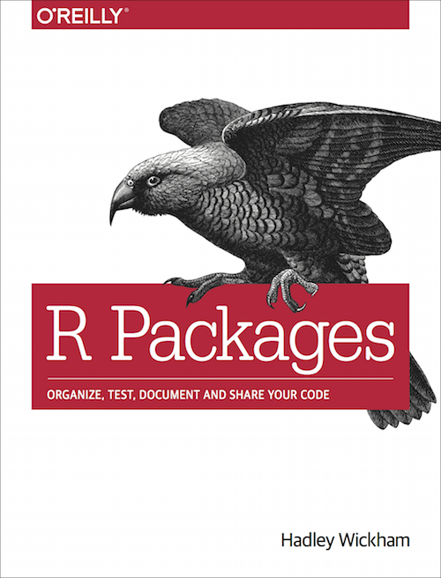
Connecting to Git & GitHub
Not enough time!

Slide 93
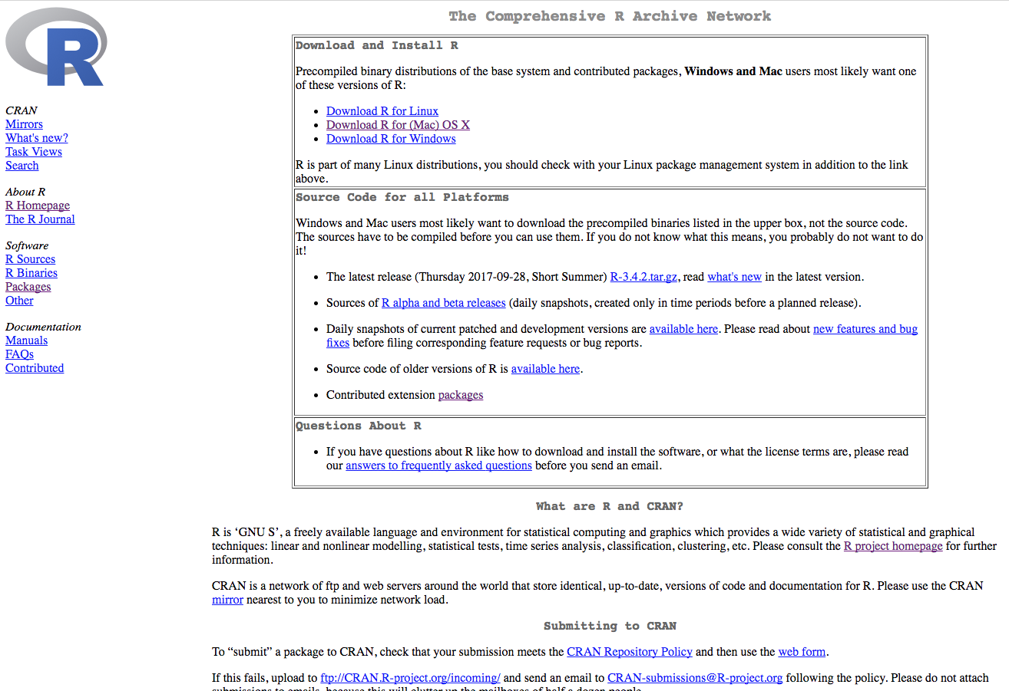
Hosting on CRAN
The centralized R package-hosting website
The install.packages command automatically downloads packages from CRAN
Designed to ensure high package quality and functionality on all systems and versions of R, including legacy, current, and devel

Slide 94
Hosting on CRAN
Before uploading to CRAN, your package must be checked for bugs
The check function from devtools will simulate the CRAN check for your system
Goal is to have: 0 errors | 0 warnings | 0 notes
Often, notes can be justifiable (i.e. “R under development (unstable)”)
devtools::test()
devtools::check()
devtools::build_win()

Slide 95
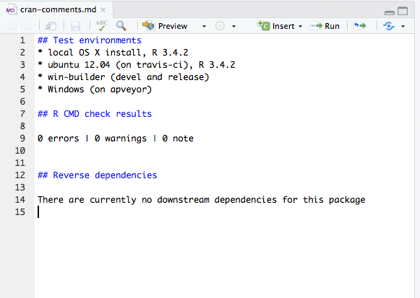
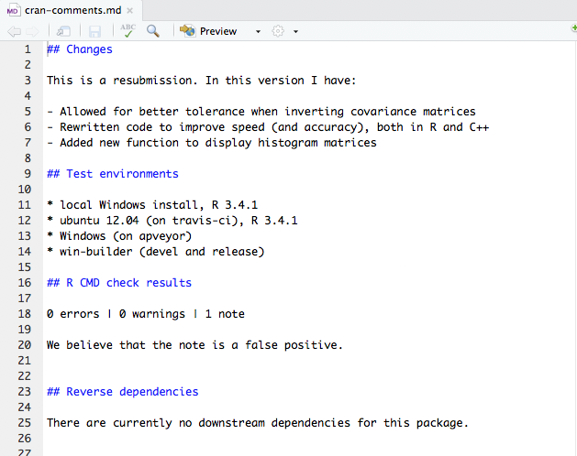
Hosting on CRAN
If your checks pass, create a cran-comments.md file
devtools::use_cran_comments()
Initial Comments
Version Update Comments

Slide 96
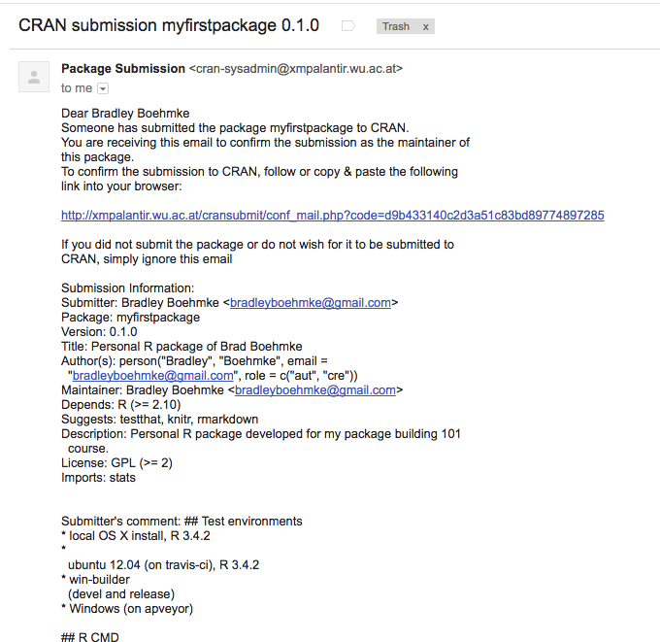
Hosting on CRAN
When you are ready to submit, run one of the following:
You will receive an email asking to confirm submission
Click link and wait for feedback!
devtools::release()
devtools::submit()

Slide 97
Programming Exercise
Expand the capability of your package

Slide 98
Your turn!
Add any custom functions you have to your personal package.
If you don’t have any, practice by incorporating the stat functions in the package-functions.R file.

Slide 99

what to remember

Slide 100
Package Creation Process
Phase | Description
Start New Project | Initialize container for holding functions and documentation files
Write Functions | Write code for what the package will do
Add Documentation | Describe how to use the functions
Add Testing | Check that changes and updates don’t affect other functions
Write a Vignette | Describe in more detail the vision for the package and how it could be utilized
Deploy | Host your package on your machine, GitHub, or CRAN

Slide 101
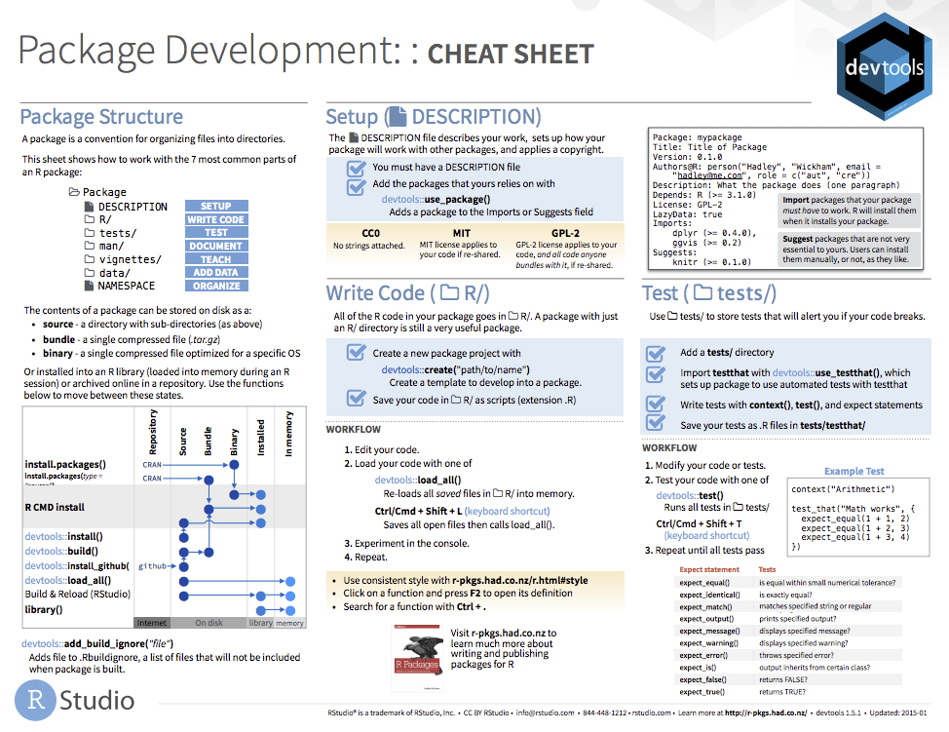
learn more

Slide 102

Questions

Slide 103
documenting functions
All functions in R come with help menus so that other users (or even yourself in the future) can figure out how to use various functions
We will be using the roxygen2 package to add documentation files
Documentation files are saved as .Rd files in the /man folder of your project
?dplyr::filter

Slide 104
CONSTRUCTING HELP FILES
Directly above the function in the .R file, add various categories with a leading #’
You should always include @title, @description, @param, @examples, and @export
Once you have incorporated these comments, type devtools::document() in your console.
This creates:
.Rd file in man directory
Adds pv function to package NAMESPACE

Slide 105
test drive your function
Once you’ve created your function and added it to the NAMESPACE you can:
# Load your development package functions
devtools::load_all()
# Look at help file documentation
?pv
# Test your function out
pv(FV = 1000, .09, n = 5)
[1] 649.93
# Test that your current package meets CRAN
# requirements
devtools::check()

Slide 106
common workflow
# Document your package functions
devtools::document()
# Load your package functions
devtools::load_all()
# Evaluate your package against requirements
devtools::check()
Shortcuts:
Ctrl/Cmd + Shift + D
Ctrl/Cmd + Shift + L
Ctrl/Cmd + Shift + E
Rinse and repeat

Slide 107
some things to remember
All functions can be written in a single .R script, each function can be in a different script, or some other configuration in between these two extremes
All of these .R scripts should be saved in the /R folder of your project
Functions can either be internal or exported
Internal functions, or “helper” functions can only be accessed within the project, unless the user calls ::: to specify an internal function
Exported functions are the typical functions that can be accessed anytime once the package has been loaded
DO NOT call libraries within functions using library()

Slide 108
Your turn!
Add the rescale function to your package:
Create new .R script
Add rescale function
Add roxygen comments to document help file
Run devtools::document() to add to NAMESPACE
Load function with devtools::load_all() (check our help file, test function)
Run devtools::check()

Slide 109
A function with dependencies
2 approaches
Add stats package to dependencies with devtools::use_package(“stats”). Then refer to function explicitly (stats::na.omit)
Add stats::na.omit to NAMESPACE with @importFrom stats na.omit
Add this dependency, rerun devtools::document() and devtools::check() and you should be clear!

Slide 110
Adding example data

Slide 111
Setting up the data
# 1. Import the data you want to use
psc <- readr::read_csv("path/to/pkg_data.csv")
# 2. Add the data object to your package
devtools::use_data(psc)

Slide 112
Setting up the data
# 1. Import the data you want to use
psc <- readr::read_csv("path/to/pkg_data.csv")
# 2. Add the data object to your package
devtools::use_data(psc)
# 3. Document data using roxygen comments then run
devtools::document()
devtools::load_all()
?psc
psc
devtools::check()

Slide 113
Integrated testing
Know when your code breaks!

Slide 114
Description File
Automated testing reduces the time to find and fix bugs
Formalizes testing to ensure consistency
To get started, run devtools::use_testthat()

Slide 115
Description File
Automated testing reduces the time to find and fix bugs
Formalizes testing to ensure consistency
To get started, run devtools::use_testthat()
Inside the tests directory, there are two things:
testthat.R file that runs tests (don’t touch!)
testthat folder where you save your tests

Slide 116
creating a test
Create a new .R script
Title it test_pv (all test files must start with “test” and I typically have one test file per function).
Save it in tests/testthat directory

Slide 117
constructing tests
test_that(“text here to describe test”, {
expect_xxx(function(x), ___)
})

Slide 118
constructing tests
test_that("pv provides proper messages and warnings", {
expect_error(pv(FV = "1000", .09, n = 5))
expect_error(pv(FV = list(1, 2, 3), .09, n = 5))
expect_message(pv(FV = 1000, .36, n = 5))
})
The common types of tests include…
Testing for warnings & messages

Slide 119
constructing tests
test_that("pv provides proper messages and warnings", {
expect_error(pv(FV = "1000", .09, n = 5))
expect_error(pv(FV = list(1, 2, 3), .09, n = 5))
expect_message(pv(FV = 1000, .36, n = 5))
})
test_that("pv has correct dimensions and output type", {
expect_is(pv(FV = 1000, .09, n = 5), "numeric")
expect_true(is.vector(pv(FV = c(1000, 2000), .09, n = 5)))
expect_length(pv(FV = c(1000, 2000), .09, n = 5), 2)
})
The common types of tests include…
Testing for warnings & messages
Testing for correct type of outputs

Slide 120
constructing tests
test_that("pv provides proper messages and warnings", {
expect_error(pv(FV = "1000", .09, n = 5))
expect_error(pv(FV = list(1, 2, 3), .09, n = 5))
expect_message(pv(FV = 1000, .36, n = 5))
})
test_that("pv has correct dimensions and output type", {
expect_is(pv(FV = 1000, .09, n = 5), "numeric")
expect_true(is.vector(pv(FV = c(1000, 2000), .09, n = 5)))
expect_length(pv(FV = c(1000, 2000), .09, n = 5), 2)
})
test_that("pv computes correctly", {
expect_equal(pv(FV = 1000, .09, n = 5), 649.93)
expect_lt(pv(FV = 1000, .09, n = 5), 650)
expect_gt(pv(FV = 1000, .09, n = 5), 649)
expect_equal(pv(FV = c(10, 20), .09, n = 5), c(6.5, 13))
})
The common types of tests include…
Testing for warnings & messages
Testing for correct type of outputs
Testing for correct computation

Slide 121
running tests
Once you’ve incorporated your tests, you can run them anytime with devtools::test() (Ctrl/Cmd + Shift + T)
Now, every time you update your functions or make changes to your package you can test quickly and consistently

Slide 122
Your turn!
Integrate testing for our rescale function:
Create test_rescale.R script and save in testthat folder
Create a test to check for:
Creating proper warnings or messages
Check for proper dimensions or output type
Computes correctly
Save and run tests with devtools::test() (Ctrl/Cmd + Shift + T)

Slide 123
Solution

Slide 124
take-away
Once you get the general pattern down, testing is not too complicated
You can create very elaborate tests
You can automate testing online with:
travis.ci
appveyor
codecov

Slide 125
take-away
Once you get the general pattern down, testing is not too complicated
You can create very elaborate tests
You can automate testing online with:
travis.ci
appveyor
codecov
Great book for digging into testing

Slide 126
Vignette
Make it easy to learn about your packages!

Slide 127
Learning about your package
Most modern packages include a vignette which:
Introduce the purpose for your package
Discuss the functions supplied by your package
Illustrates how someone can use your package
vignette("dplyr")

Slide 128
creating a vignette
Initialize a vignette with devtools::use_vignette():
Creates a vignettes/ directory
Adds necessary dependencies to DESCRIPTION file
Creates a draft vignette
devtools::use_vignette("myfirstvignette")

Slide 129
creating a vignette
If you are familiar with R Markdown then vignettes are a piece of cake:
Run devtools::install() in your console to install development version of package on your computer.
Update YAML
Add your own text and headers
Include code chunks (load your package like any other package - library(myfirstpackage))
Anything else you’d want to include to explain this package

Slide 130
creating a vignette
When you are ready just knit to html_vignette (Ctrl/Cmd + Shift + K)

Slide 131
Your turn!
Take 5 minutes to edit your vignette

Slide 132
Local Deployment
Create a local source package to share

Slide 133
before sharing!
Be sure to run your local tests and checks prior to sharing!
devtools::test()
devtools::check()
Assuming everything checks out fine, let’s proceed with sharing our package

Slide 134
Creating the source file
To share locally, we need to save our packages as a .tar.gz files
devtools::build()
You can now pass along this .tar.gz file

Slide 135
Loading a source file
Load this package with install.packages(“path”, repos = NULL, type = “source”)
# install package from a raw source file
install.packages("/Users/bradleyboehmke/Desktop/myfirstpackage_0.1.0.tar.gz", repos = NULL, type = "source")

Slide 136
Your turn!
Create your source file.
Email to your neighbor.
Load your neighbor’s package.

Slide 137
Public Deployment
Host your package on GitHub or CRAN

Slide 138
Hosting on GitHub
Git & GitHub provide a free version control capability
Allows for easy collaboration and beta development of packages
Allows you to tie into travis.ci, appveyor, codecov and other integrated testing platforms
RStudio allows you to easily integrate GitHub interactions within the IDE

Slide 139
Bugs, suggested improvements, etc.
Collaborators
History
Integrated testing
Package info for public

Slide 140
Hosting on GitHub
To install a package already on GitHub, you must know the Username and Repository that the package resides in
Once you have this information, the install_github command will install the package on your computer.
Because of the size of most vignettes, devtools does not automatically download them from GitHub. If you want to include the vignette, you must add the argument build_vignettes = TRUE
To start posting to GitHub, you will first need to install and set up Git, which is what you'll use to communicate with GitHub. Start by visiting http://git-scm.com/download and installing Git for your system.
# download package from GitHub
devtools::install_github(“Username/Repository”, build_vignettes = TRUE)

Slide 141
Connecting to Git & GitHub
Not enough time!

Slide 142
Hosting on CRAN
The centralized R package-hosting website
The install.packages command automatically downloads packages from CRAN
Designed to ensure high package quality and functionality on all systems and versions of R, including legacy, current, and devel

Slide 143
Hosting on CRAN
Before uploading to CRAN, your package must be checked for bugs
The check function from devtools will simulate the CRAN check for your system
Goal is to have: 0 errors | 0 warnings | 0 notes
Often, notes can be justifiable (i.e. “R under development (unstable)”)
devtools::test()
devtools::check()
devtools::build_win()

Slide 144
Hosting on CRAN
If your checks pass, create a cran-comments.md file
devtools::use_cran_comments()
Initial Comments
Version Update Comments

Slide 145
Hosting on CRAN
When you are ready to submit, run one of the following:
You will receive an email asking to confirm submission
Click link and wait for feedback!
devtools::release()
devtools::submit()

Slide 146
Programming Exercise
Expand the capability of your package

Slide 147
Your turn!
Add any custom functions you have to your personal package.
If you don’t have any, practice by incorporating the stat functions in the package-functions.R file.

Slide 148
what to remember

Slide 149
Package Creation Process
Phase | Description
Start New Project | Initialize container for holding functions and documentation files
Write Functions | Write code for what the package will do
Add Documentation | Describe how to use the functions
Add Testing | Check that changes and updates don’t affect other functions
Write a Vignette | Describe in more detail the vision for the package and how it could be utilized
Deploy | Host your package on your machine, GitHub, or CRAN

Slide 150
learn more

Slide 151
Questions

